Slide 1
Cellular Modeling V1
Daniel Chen

Slide 2
Goals
Cell-cell interactions are hard to measure in-vivo I seek to model this behavior and the ways it affects different cells
Evolution of cells and their genetic changes remains a mystery I hope to discern the sequence of events that occurs to terminal states
Life has achieved an incredible amount of diversity yet it is unclear how this occurred and what phenotypes were excluded this model aims to reveal the evolution population dynamics that occur when diverse phenotypes are set in competition with each other

Slide 3
Design
Two core elements: food and cells
We add a third element called vents aimed to create a food source
This aims to replicate underwater vents that provide energy and the discrete nature of food sources that often radiate food particles or signals
One main food behavior: diffusion-based movement
Four main food behaviors: biased random walk movement, eating food, division with high health, death upon low health or age
These are facilitated by helper functions

Slide 4
Food
Attributes
Center – where is the center of the food
Radius – how large is the food
Vent – which vent produced it
This is honestly something that does not need to be tracked
Interactions
Needs to see if cell is touching food
If it is then it is eaten and deleted
Needs to see where the food should move based on vents

Slide 5

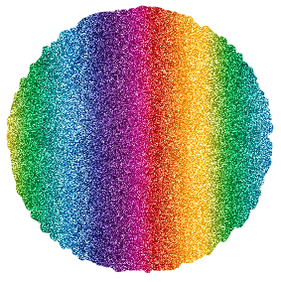
Cell
Attributes
Center – where is the center of the cell
Radius – how large is the cell
Health – sum of food - movements
Age – how long the cell has lived
Mutation rate – how to mutate traits
Interactions
Needs to see if cell is too aged
Needs to see if cell is of bad health
Needs to see if cell is so healthy that it can actually divide and reproduce

Slide 6
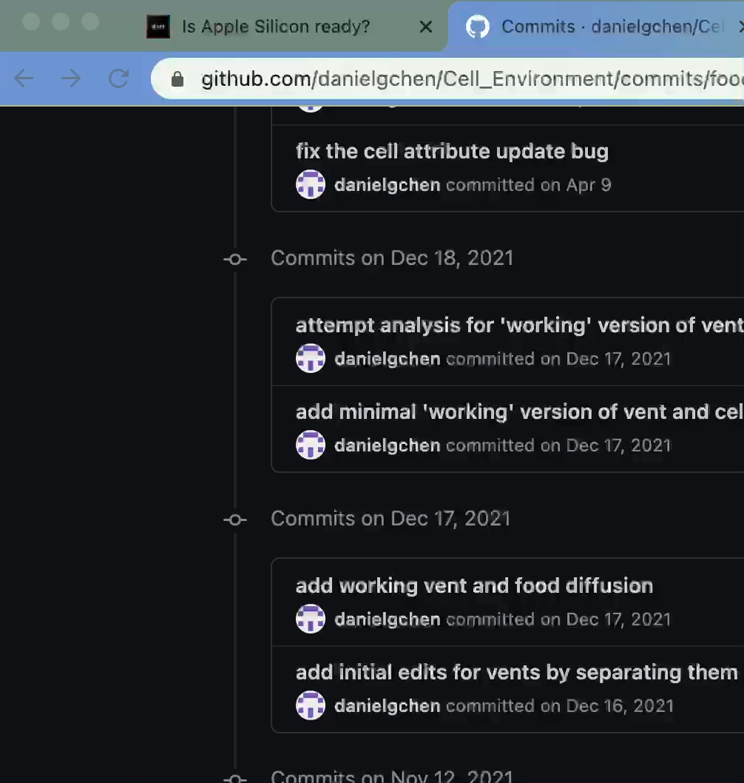
Intermediate Approach
Here is an intermediate where we can see the vents and food
We see independent evolutions and growth of cells but we do not see the food diffusing with Brownian motion nor the cells interacting with each other
We can try to develop parameters for this but they are often going to be biased and not realistic of truth

Slide 7
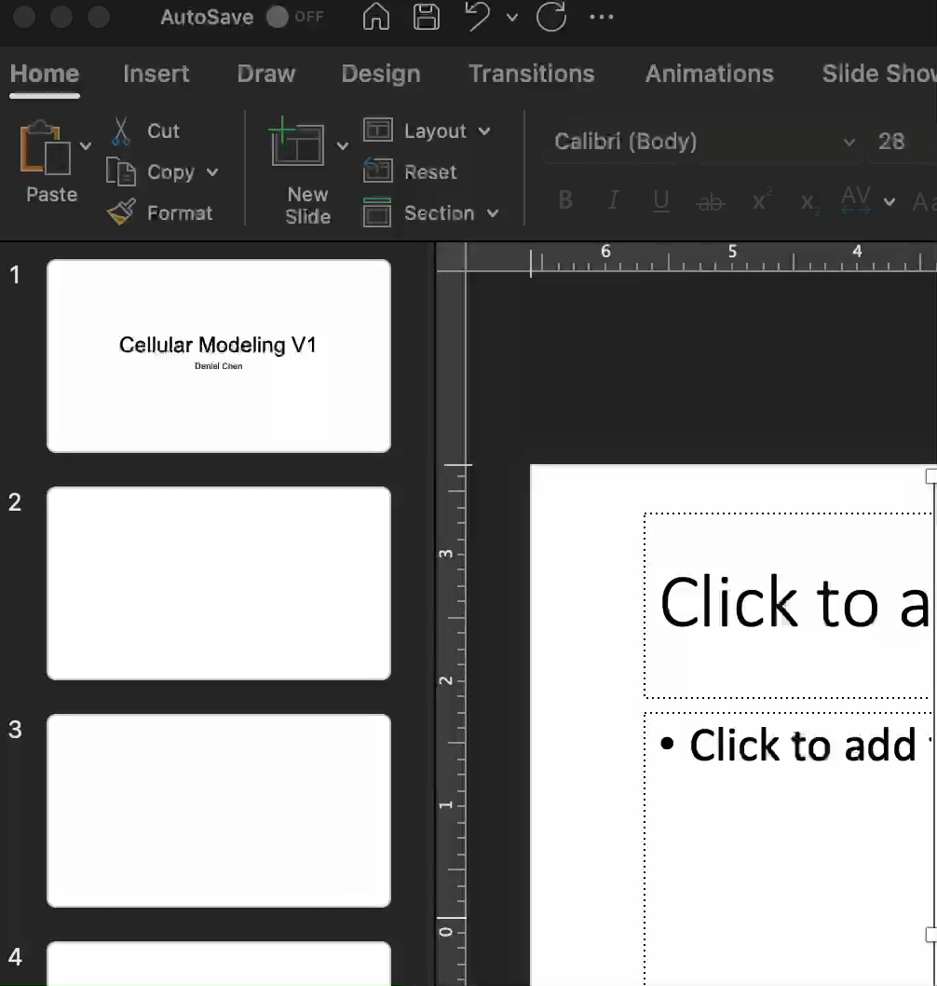
Final Approach
Here we see the food moving with Brownian motion but we do not see the cells imitating the true behavior of being repulsed by the vents

Slide 8
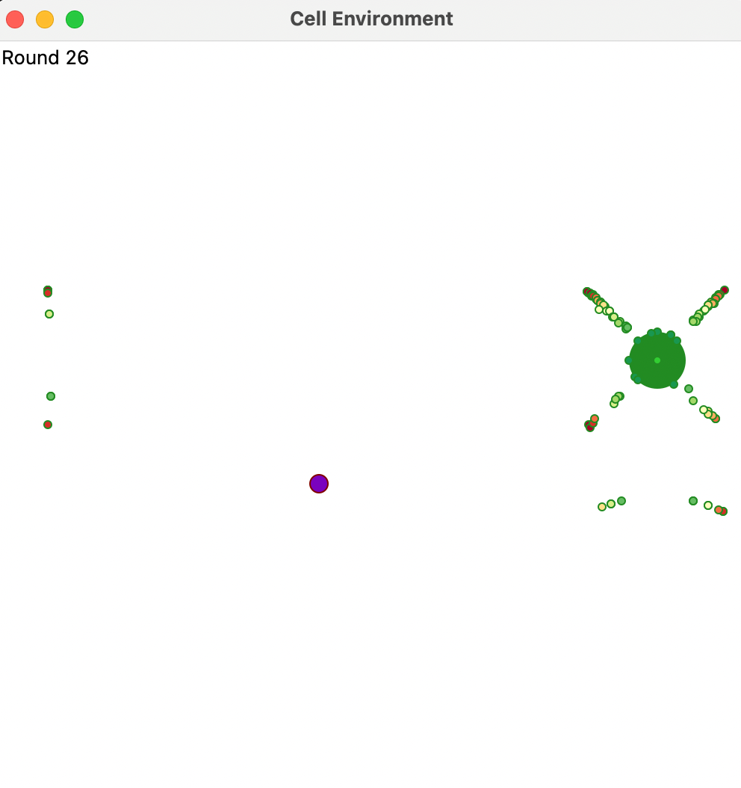
Next Steps
Here we try to make sure the food moves slower as it moves away from the vent but there are many bugs and we can see that represented by the weird pattern they take on

Slide 9
Analysis of the Model

Slide 10
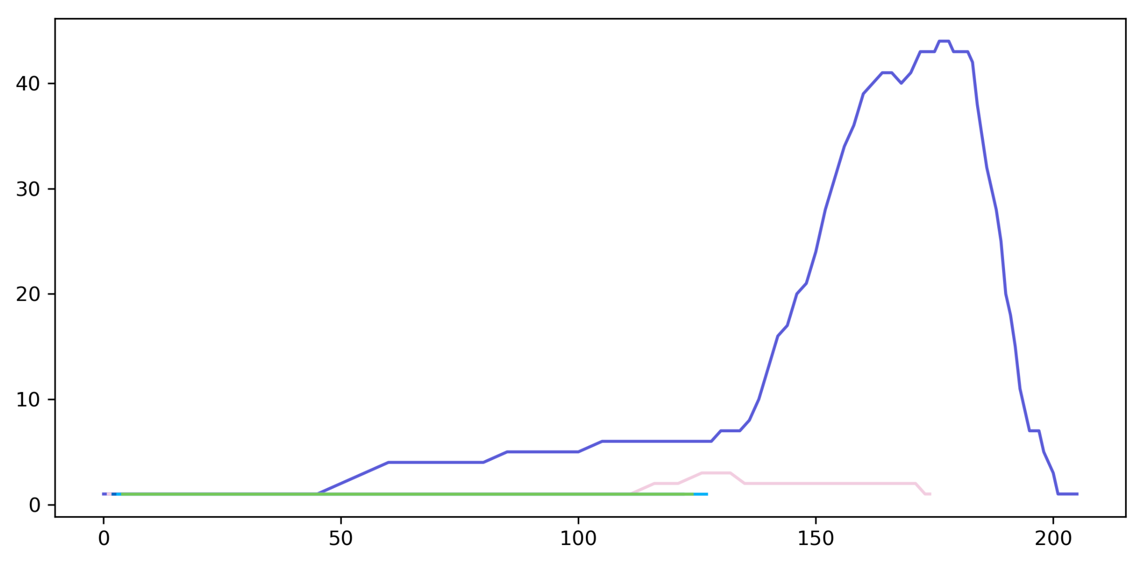
These are population dynamics where the y-axis is the number of cells and the x-axis is the number of rounds which can be thought of as time

Slide 11
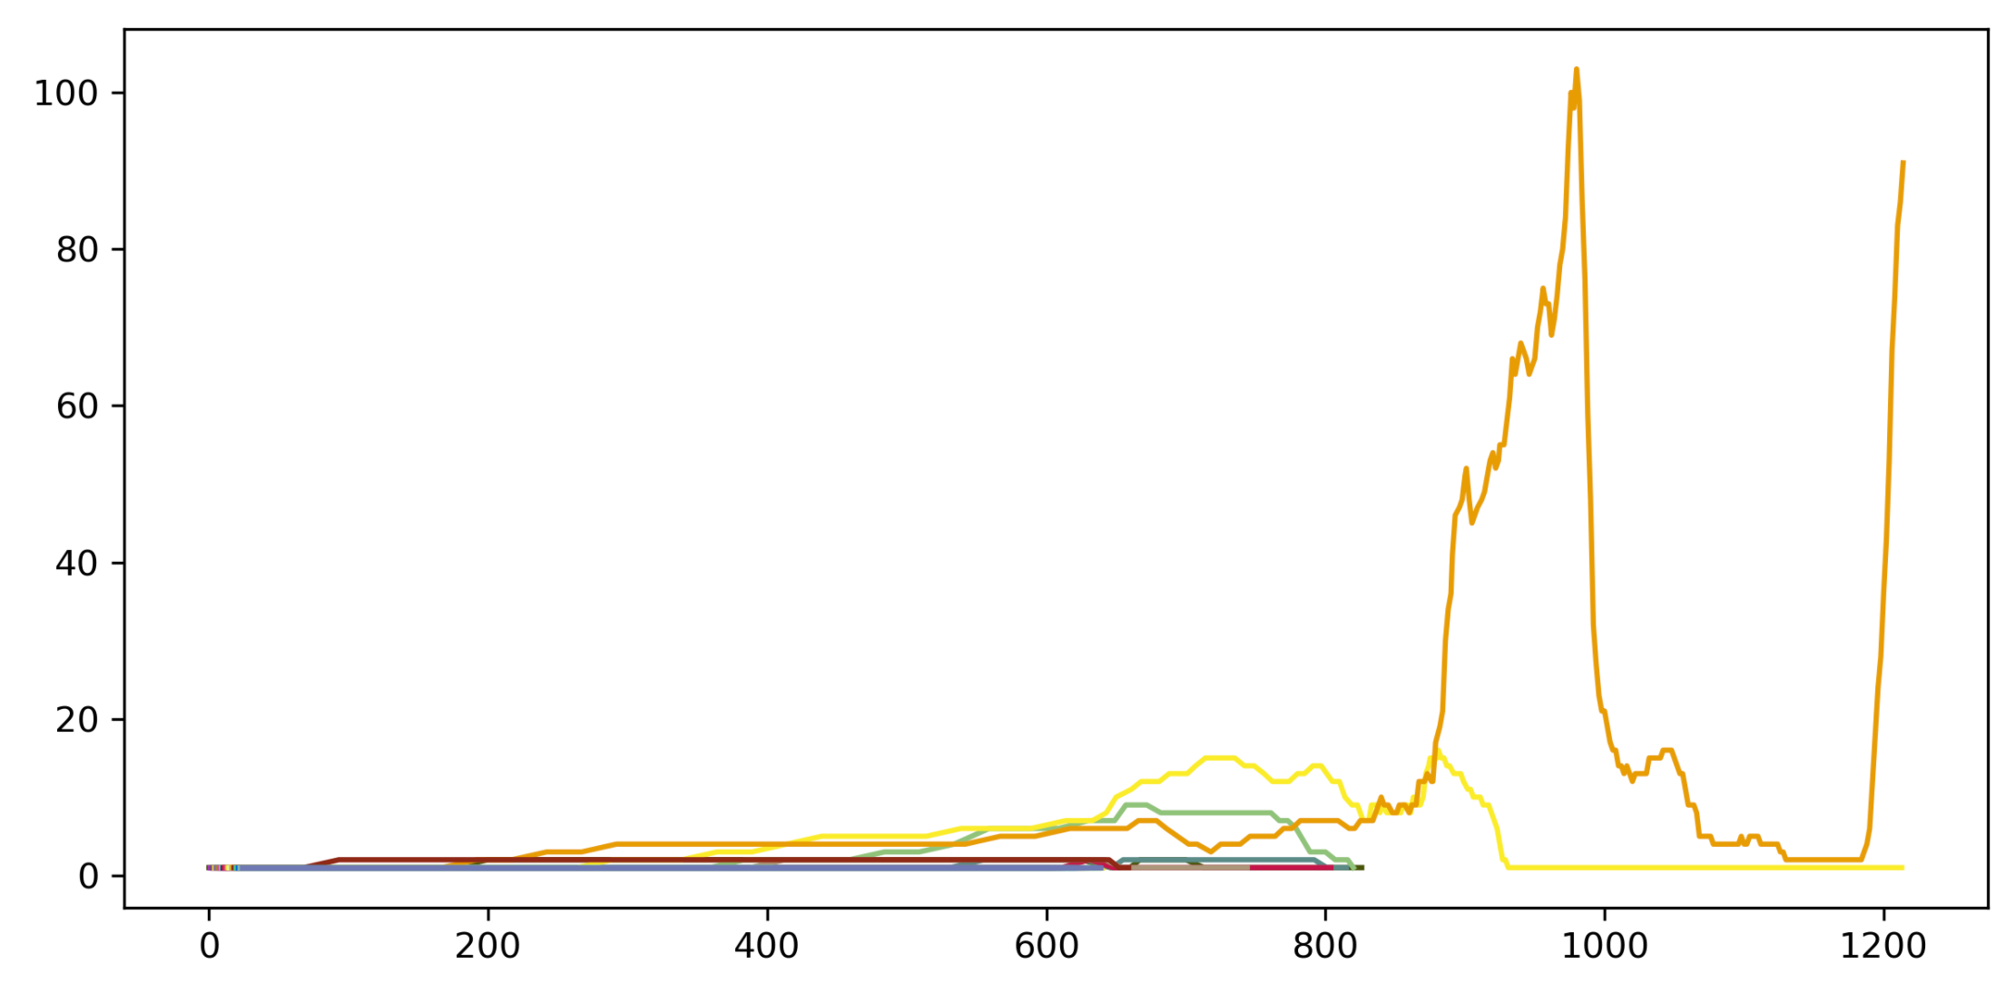
A more complex population dynamic representing boom and bust like cycles

Slide 12
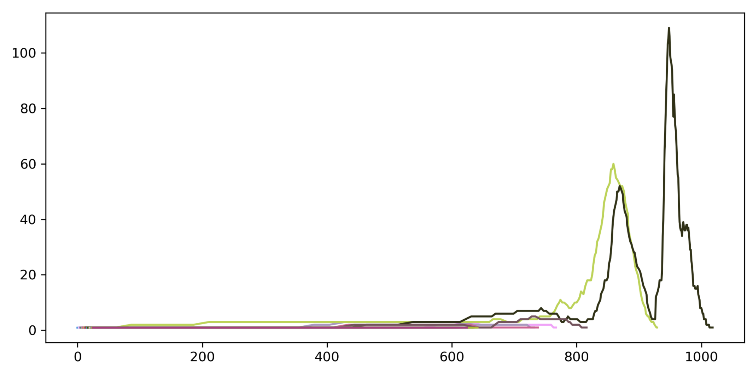
Better boom and bust where we see the dying off of one population setting off or appearing to set off the peak of another population of cells

Slide 13
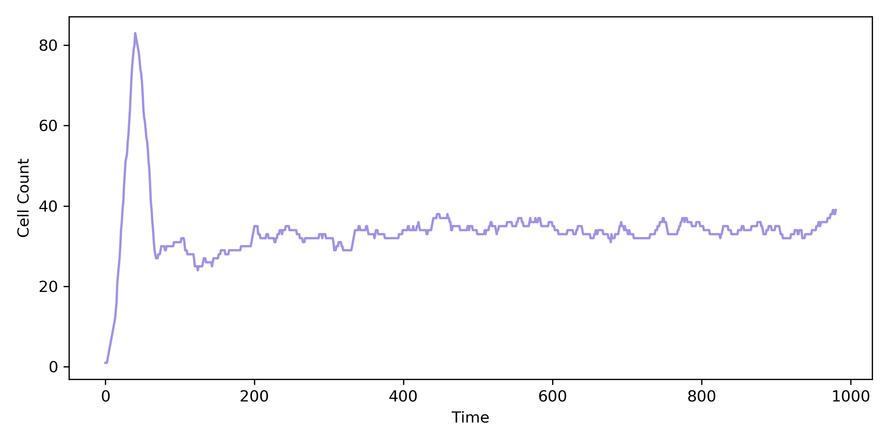
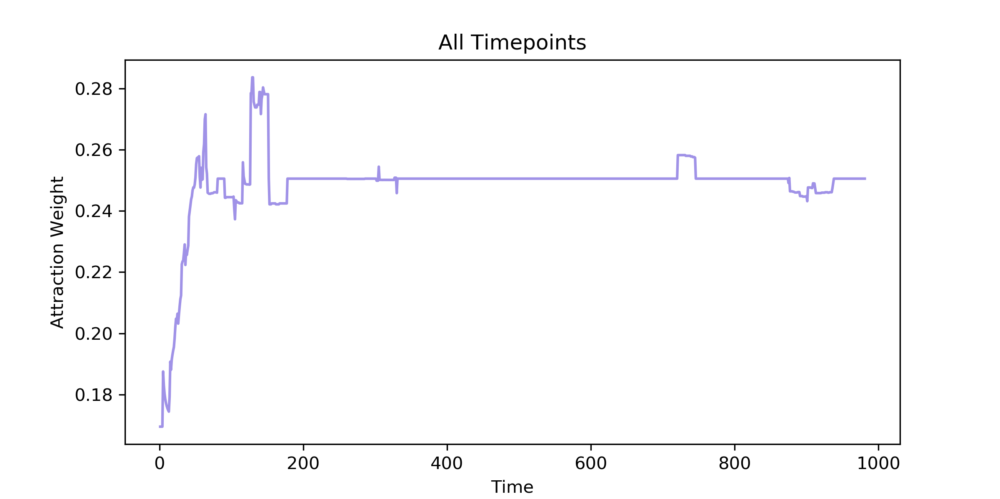
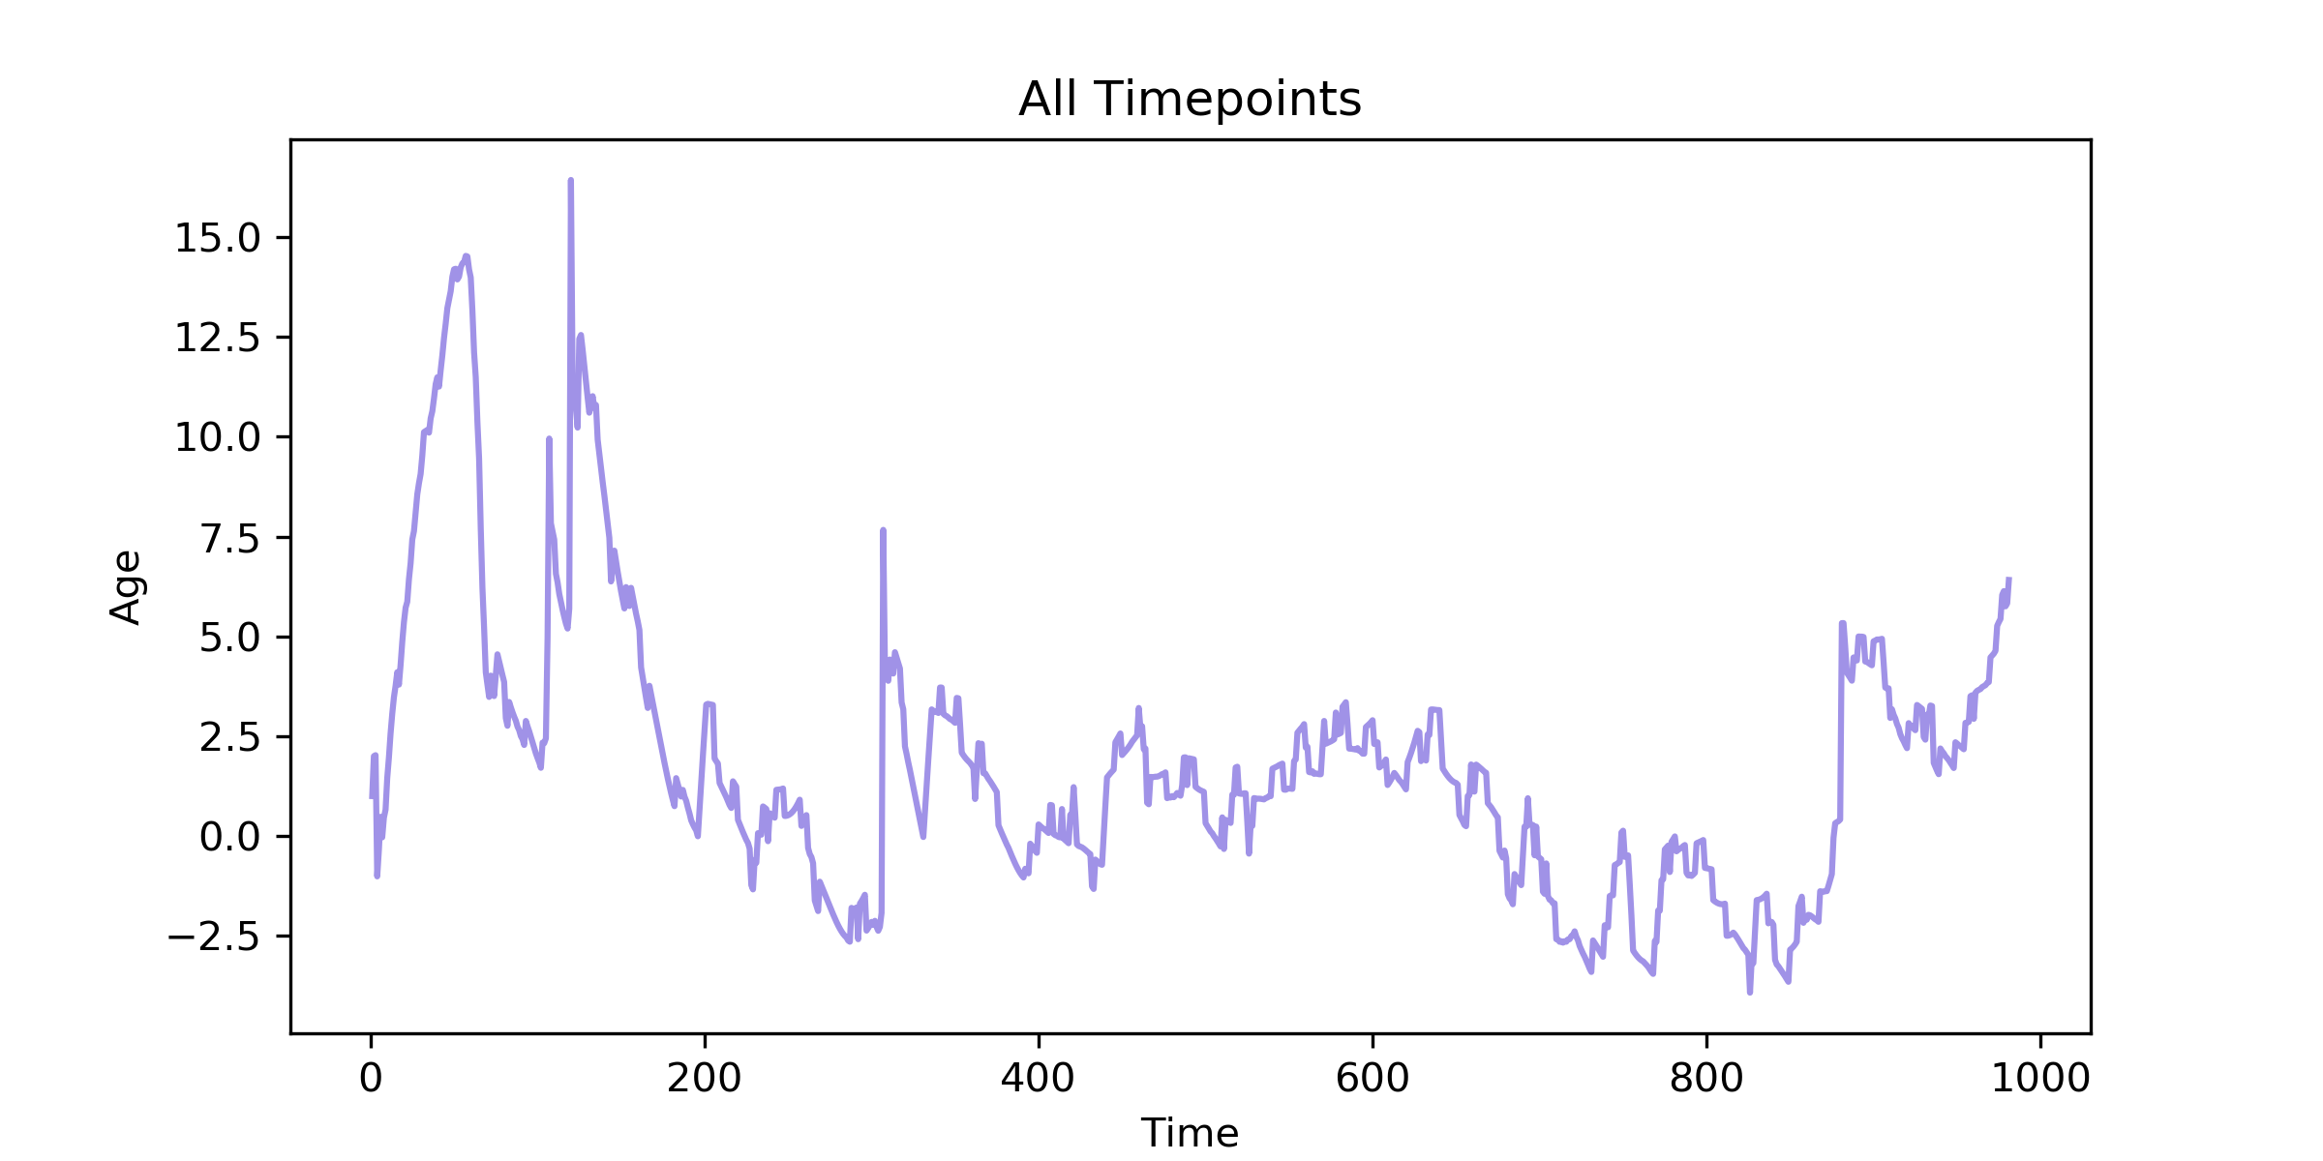
These are the different parameters that can be changed by cells or that are measured by us and how they changed for a population of cells in the environment
In full transparency I do not know how these cells lived but I do know the general trait changes are representative of what we see

Slide 14
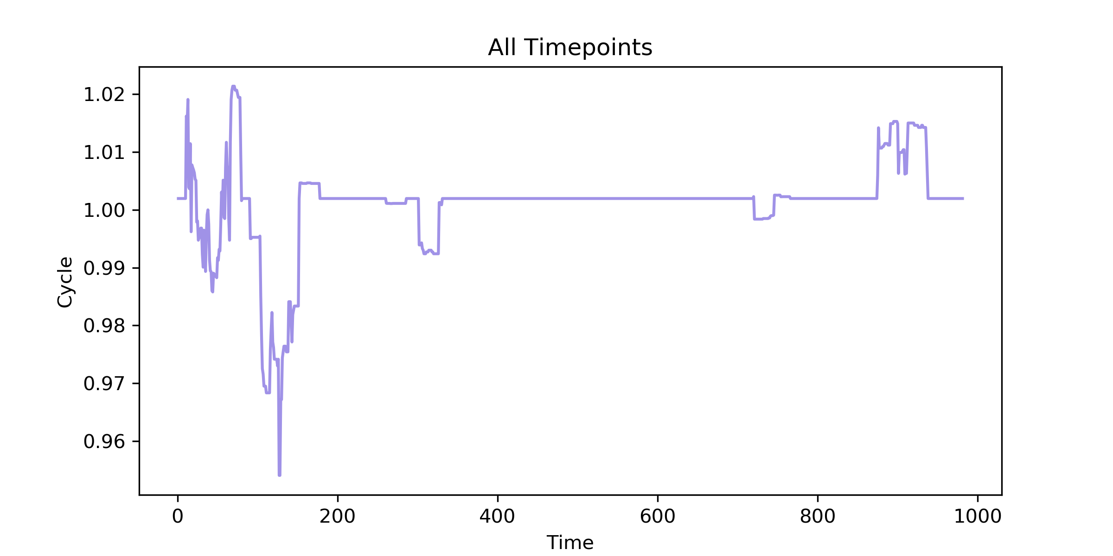
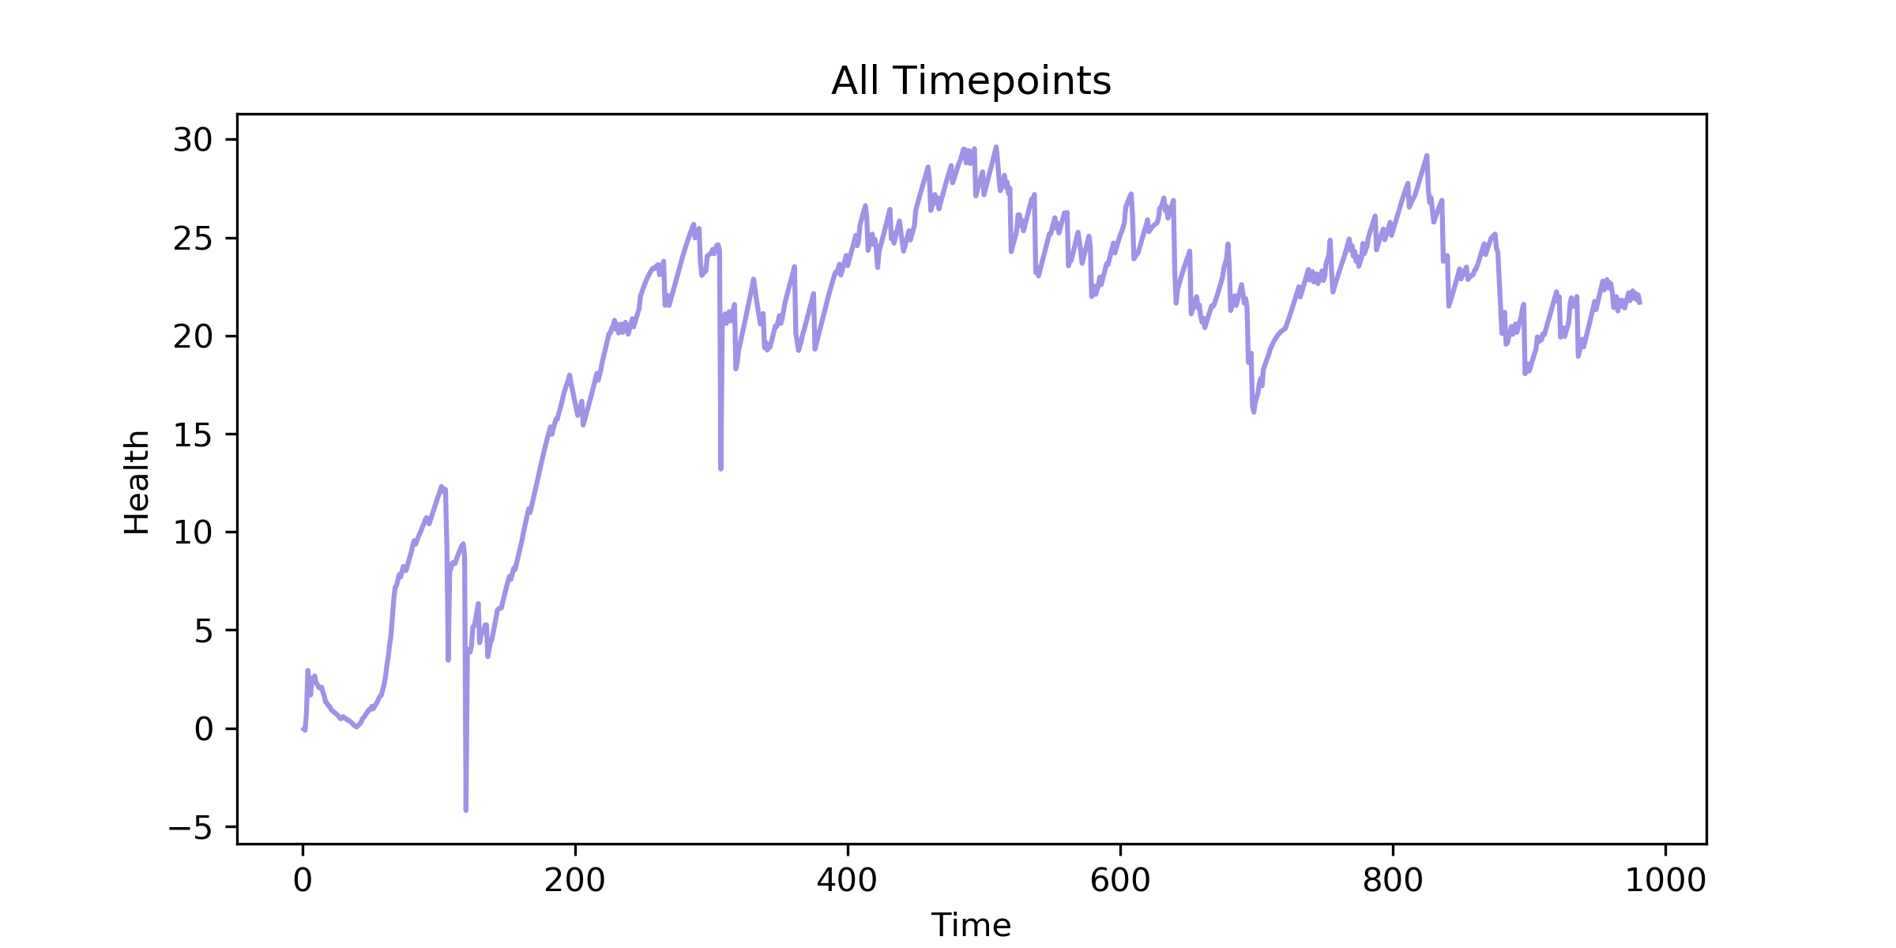
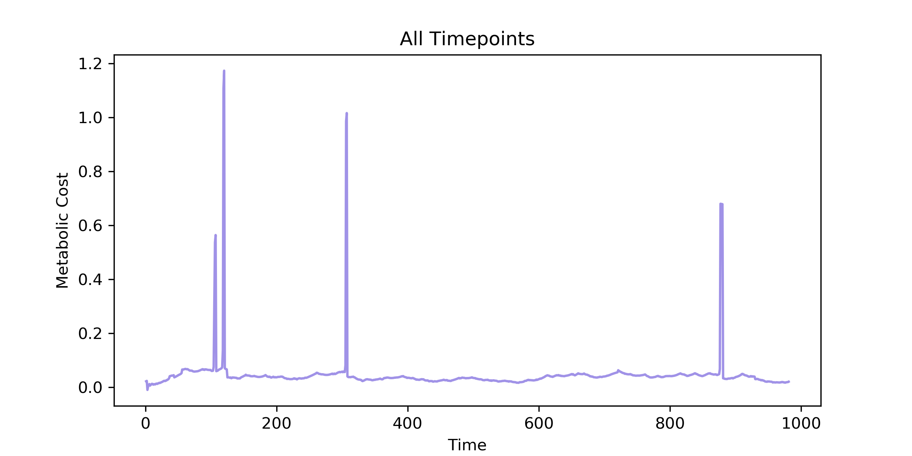
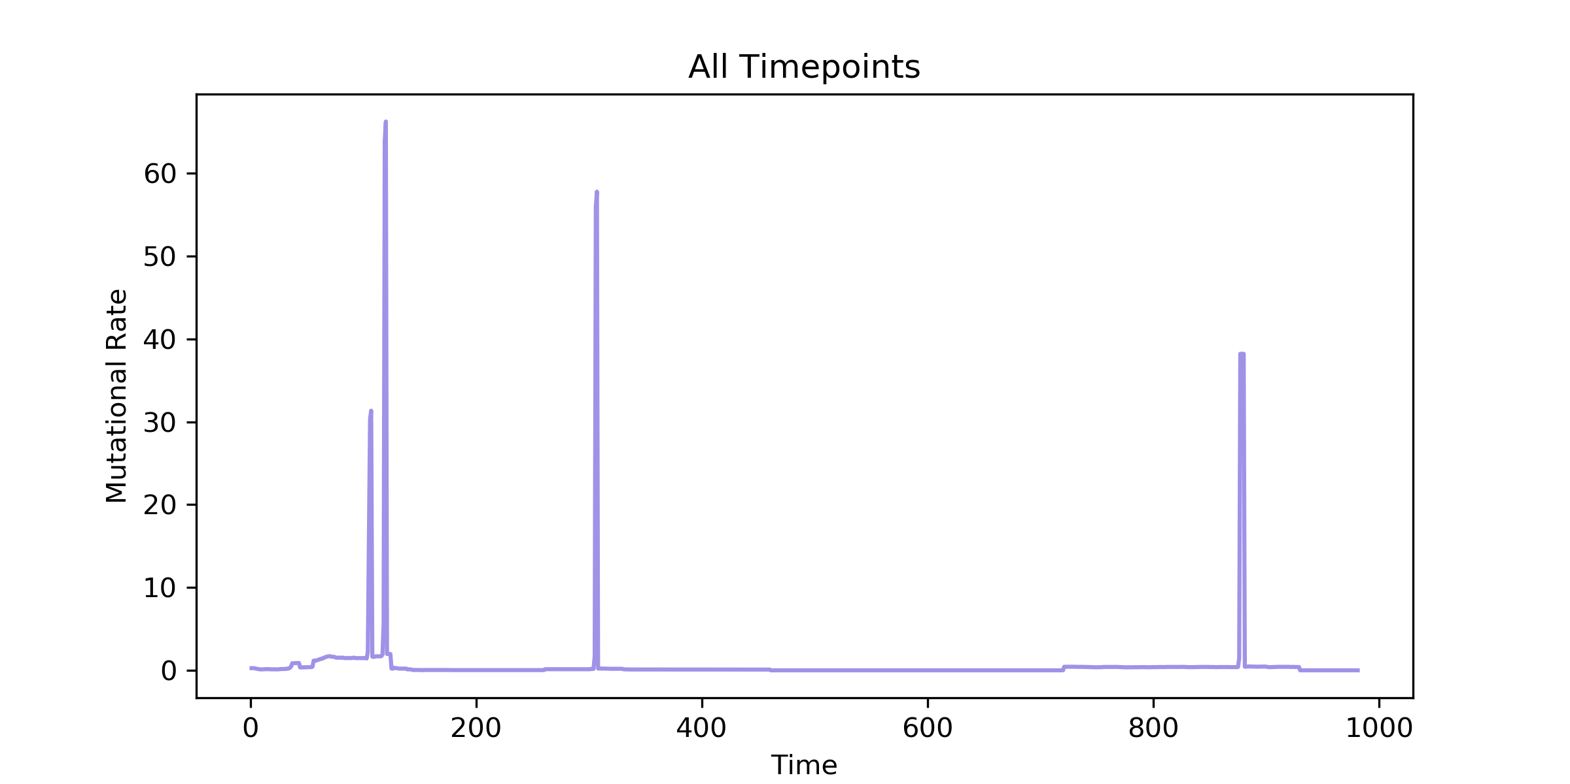

Slide 15
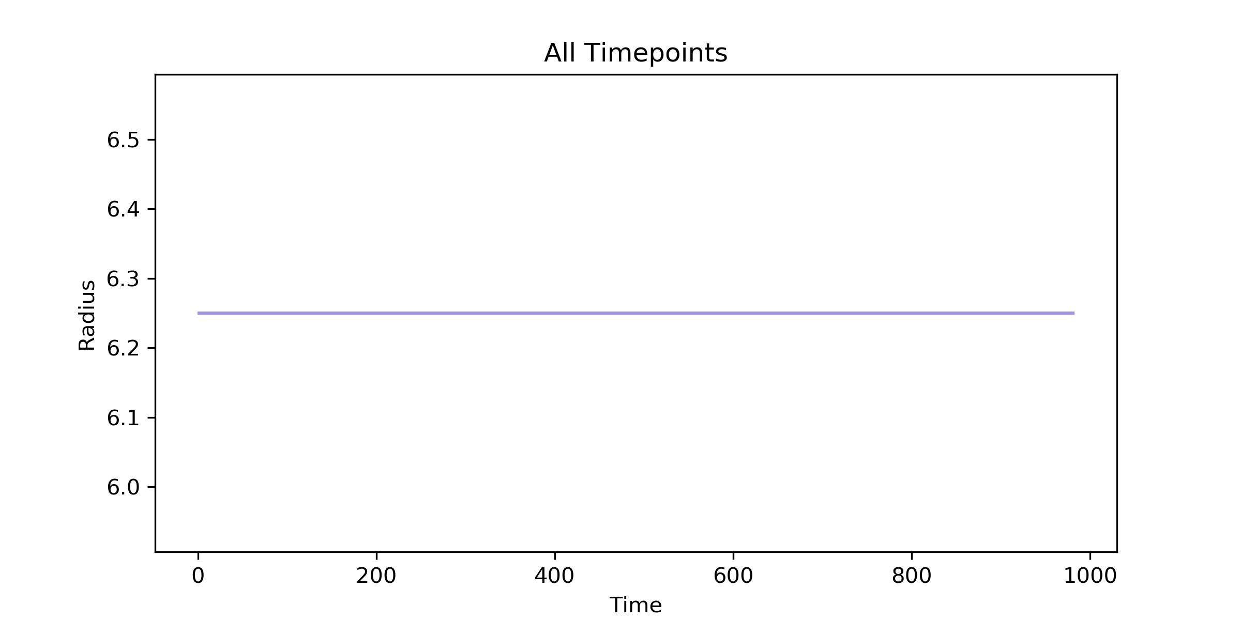
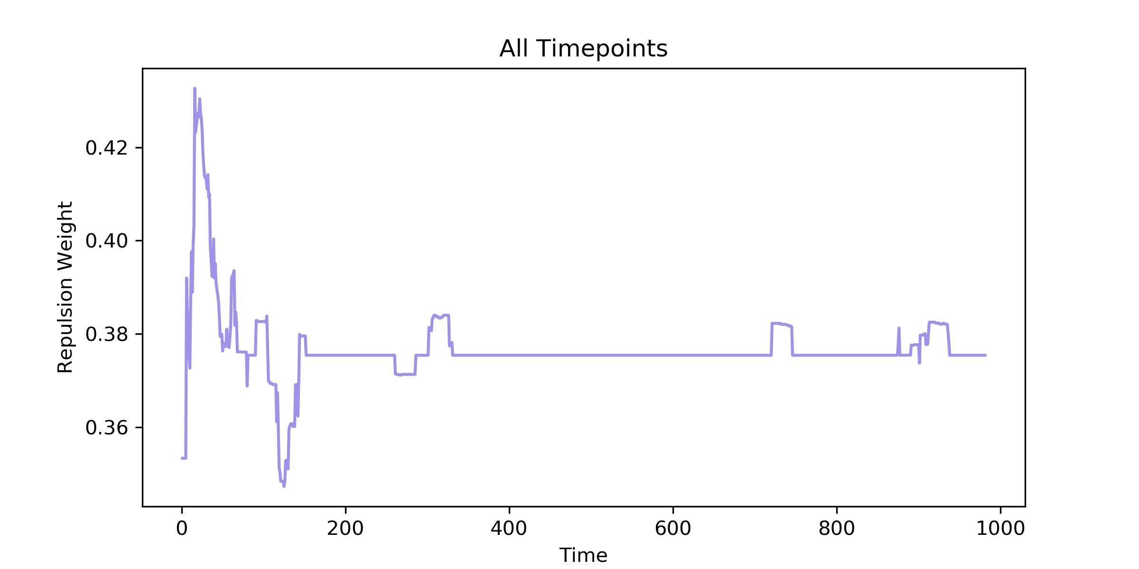
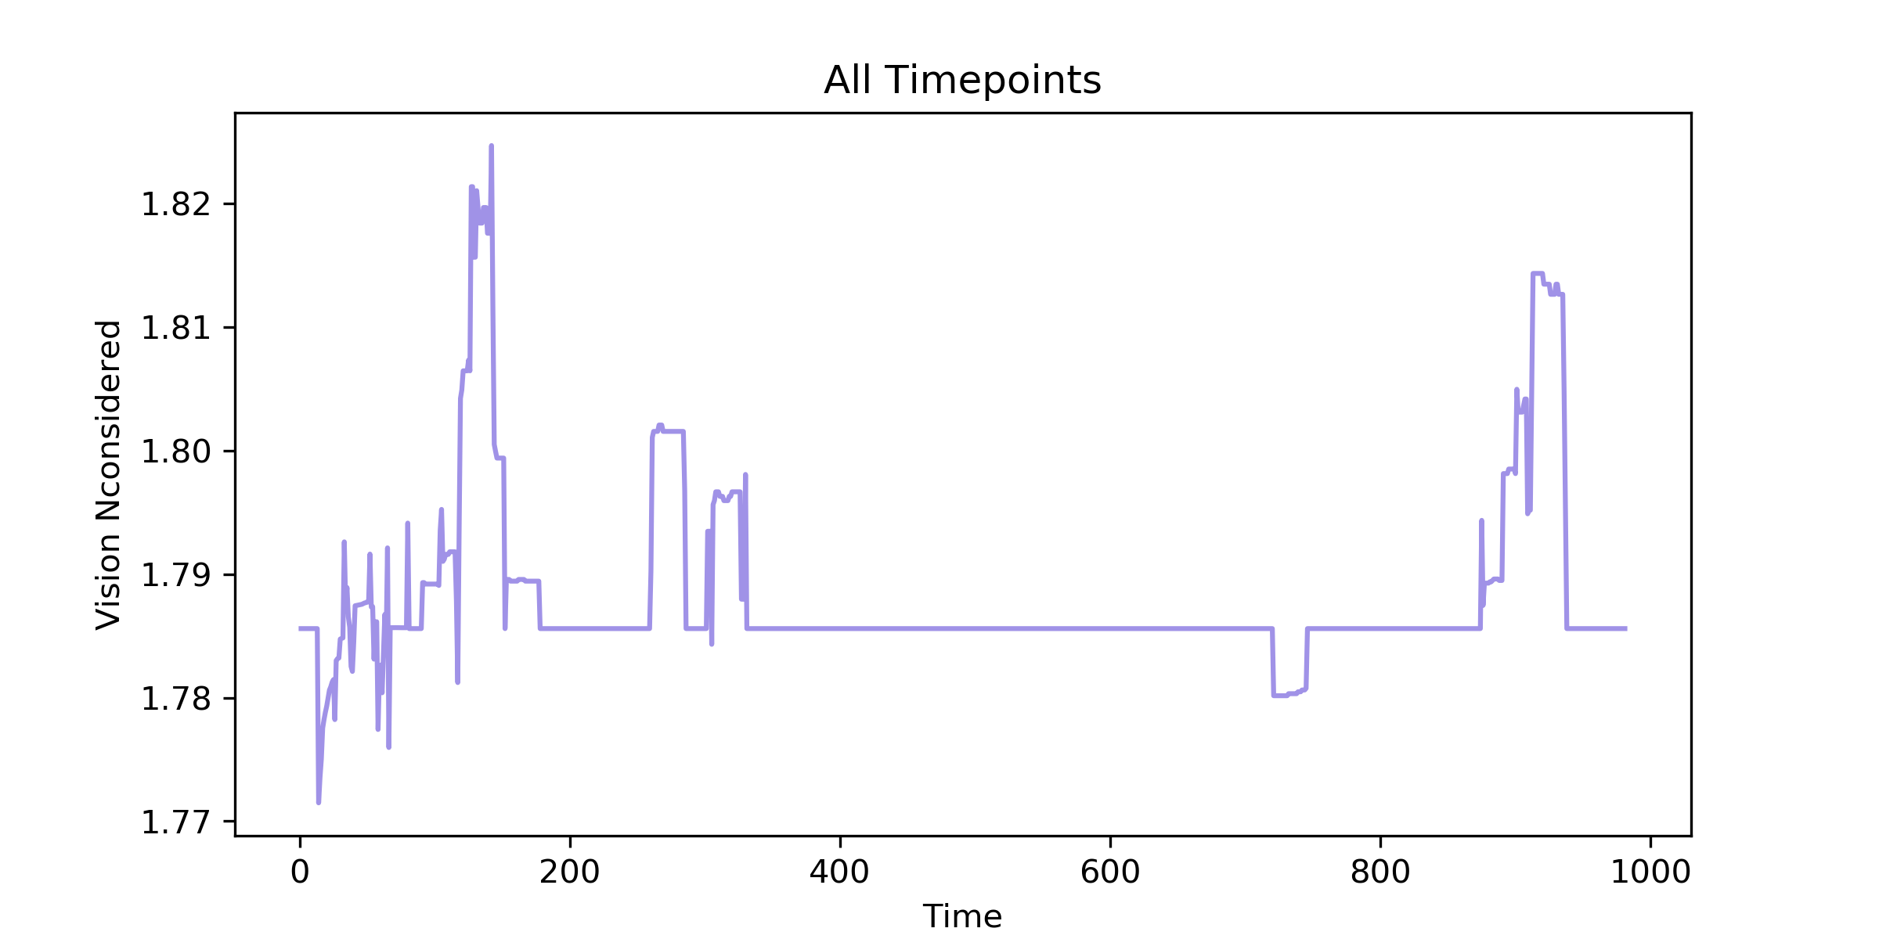
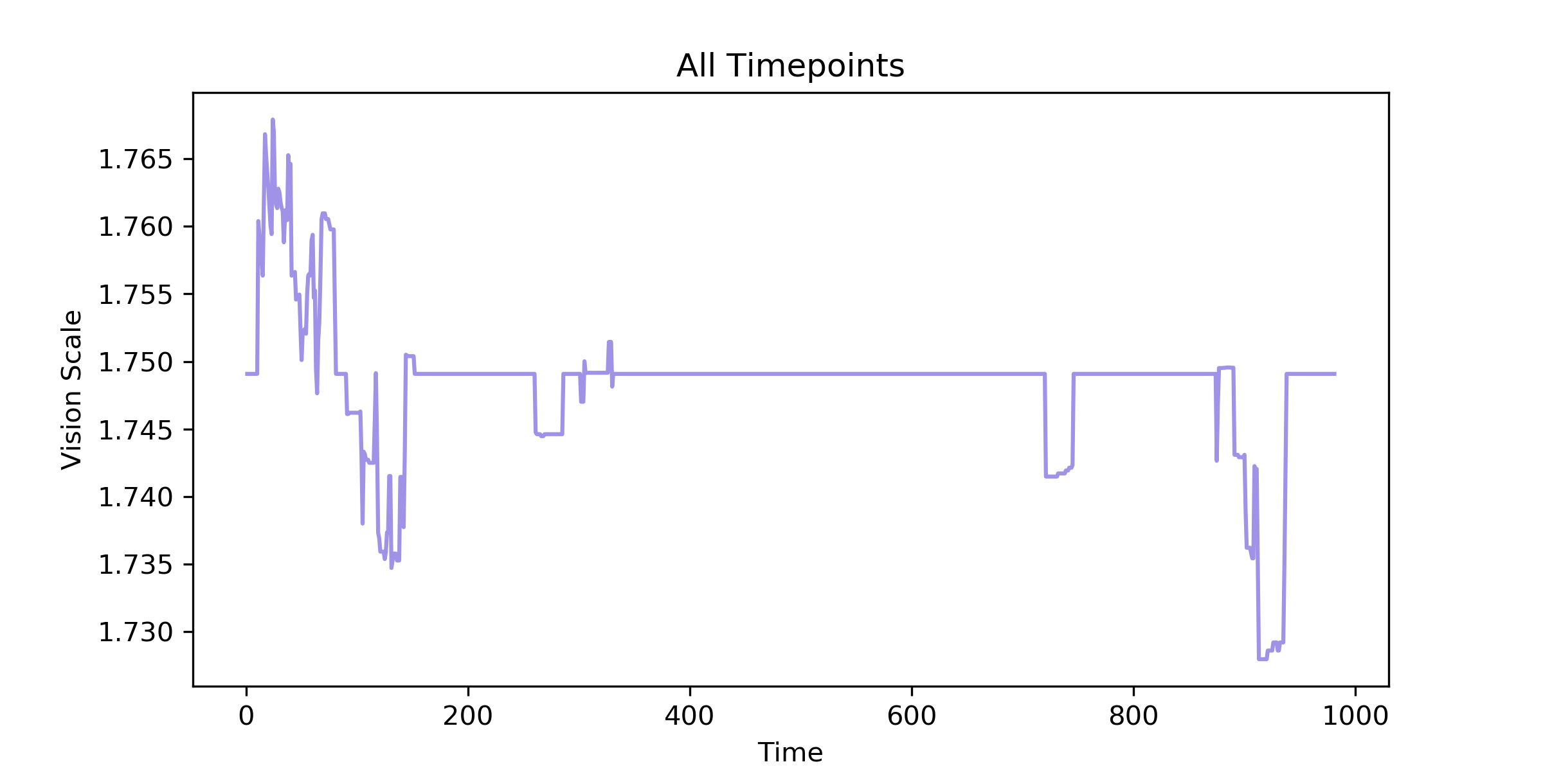

Slide 16
Takeaways
This model seems to be able to represent cellular dynamics and show the push and pull between food sources and cells
It does seem to model the competition aspect of cells
It does not model true physical behaviors which may be okay
It does not model the cell-cell interactions realistically
There are some buggy parts of the code
Mutation rate should not exceed 1 so I don’t know why it spikes above it
I do not know how to explain the random spikes we see
I do not know why there are random plateaus then softer spikes

Slide 17
Appendix

Slide 18
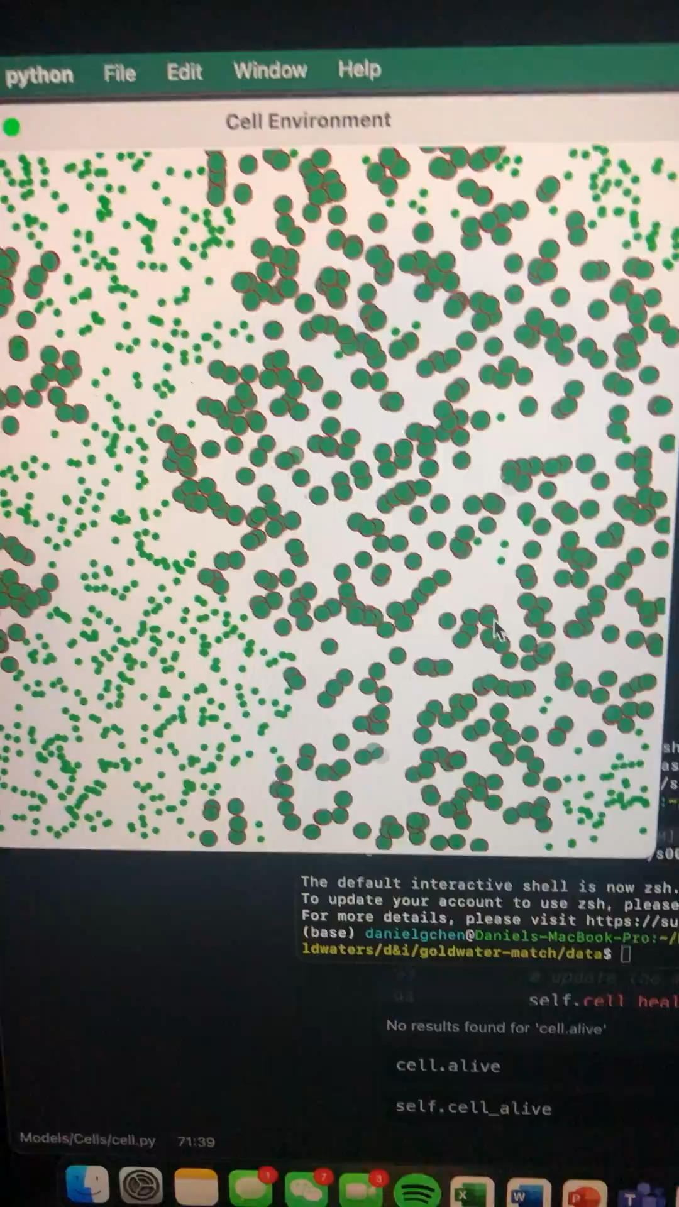
Video of a mono-cell population where food is generated from a random basis

Slide 19
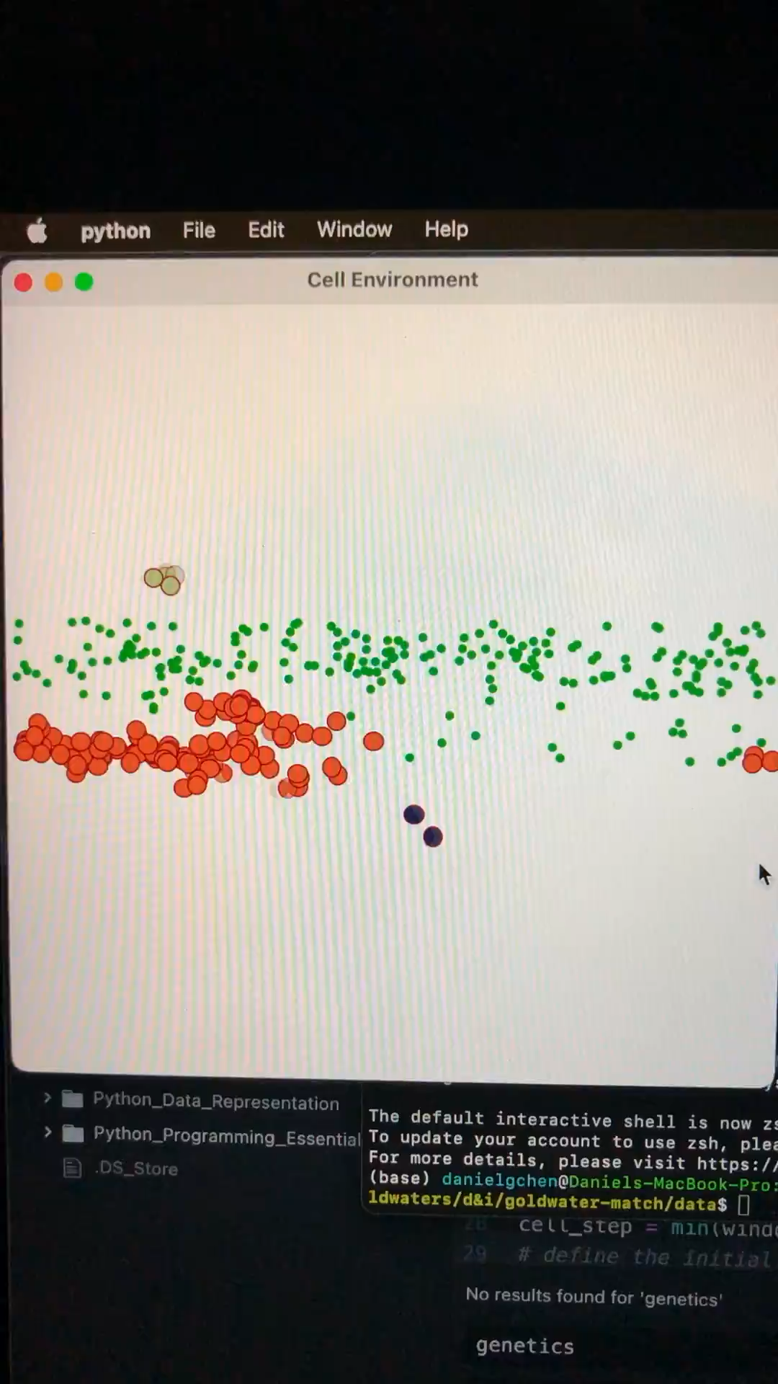
Cells moving in a continuous line, I believe this was before pausing was introduced as a feature and food is generated as a horizontal strip

Slide 20
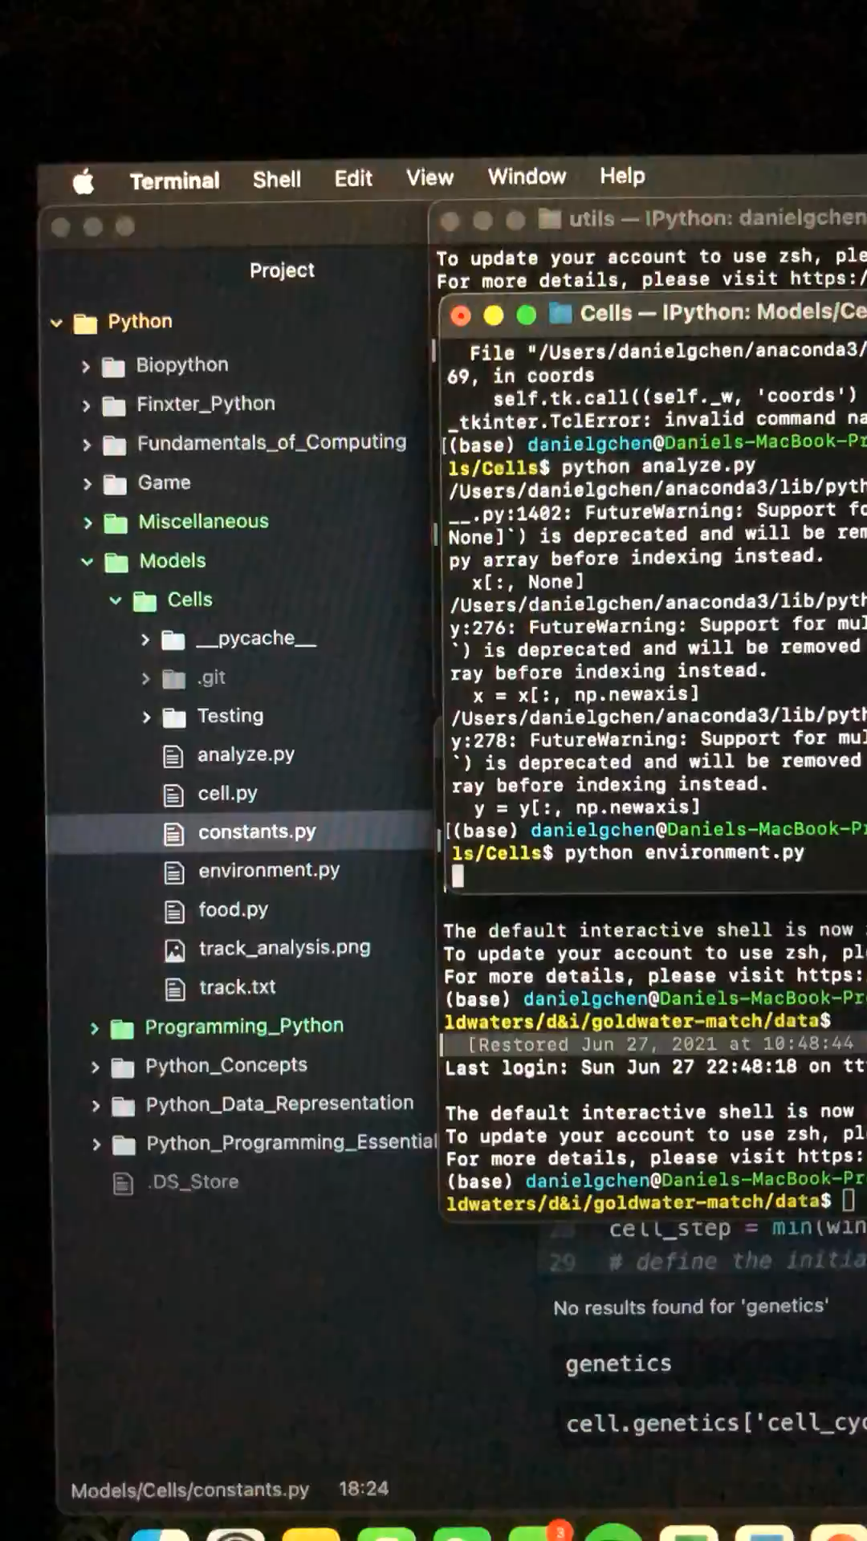
Cells could really only move in one direction here and I wanted to fix this later on

Slide 21
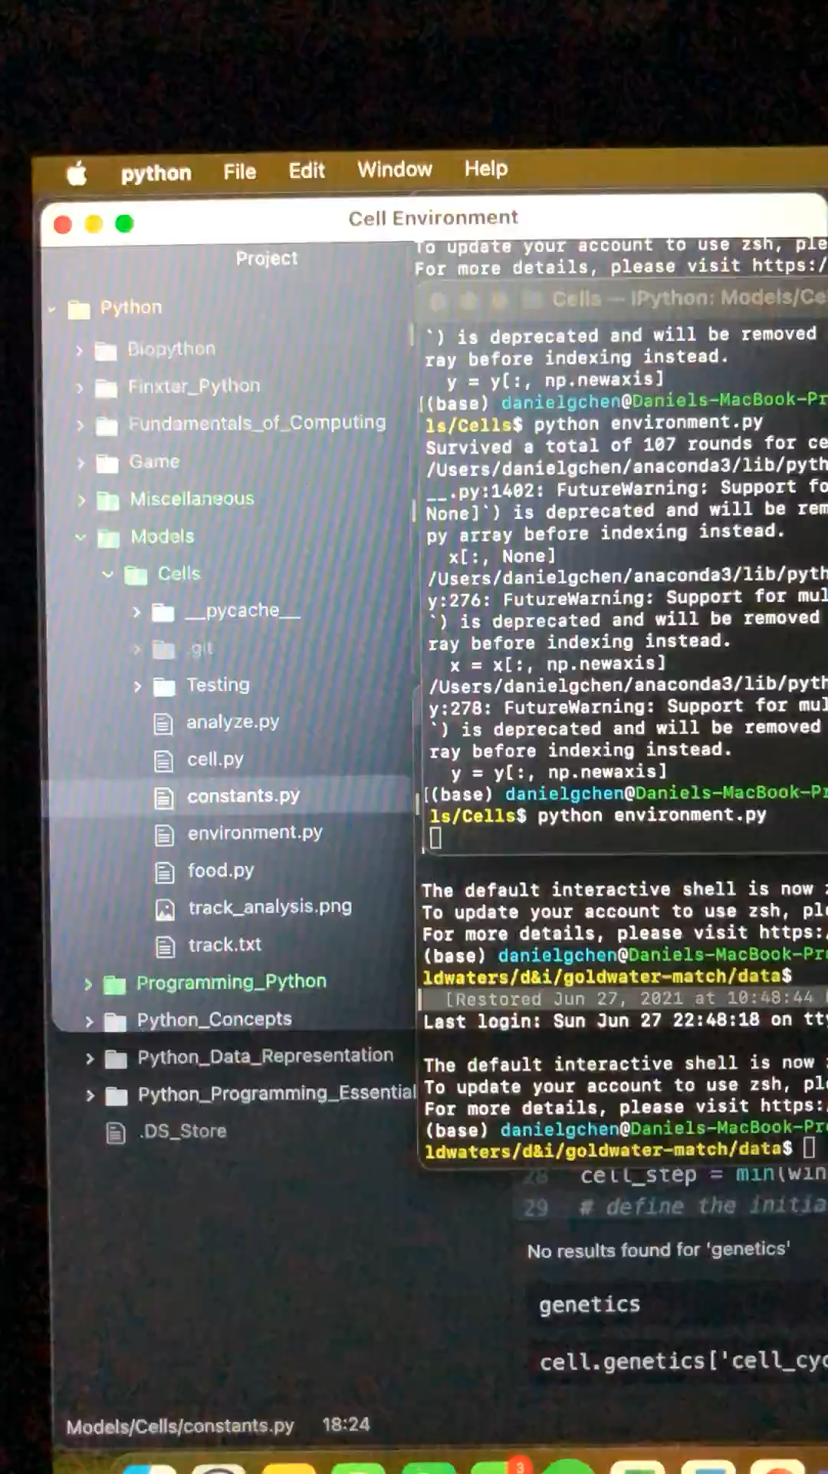
More random movement but one direction

Slide 22
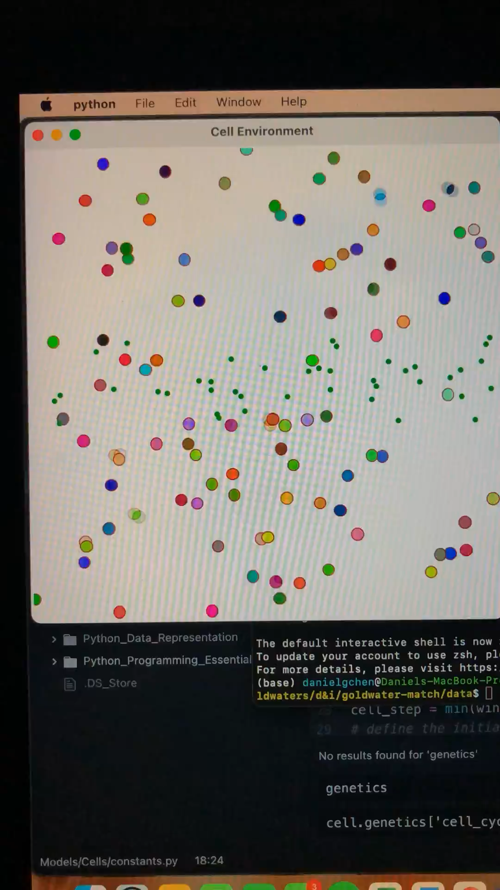
More videos basically I moved away from this because the cells were not developing any smart behaviors they were just by random chance

Slide 23
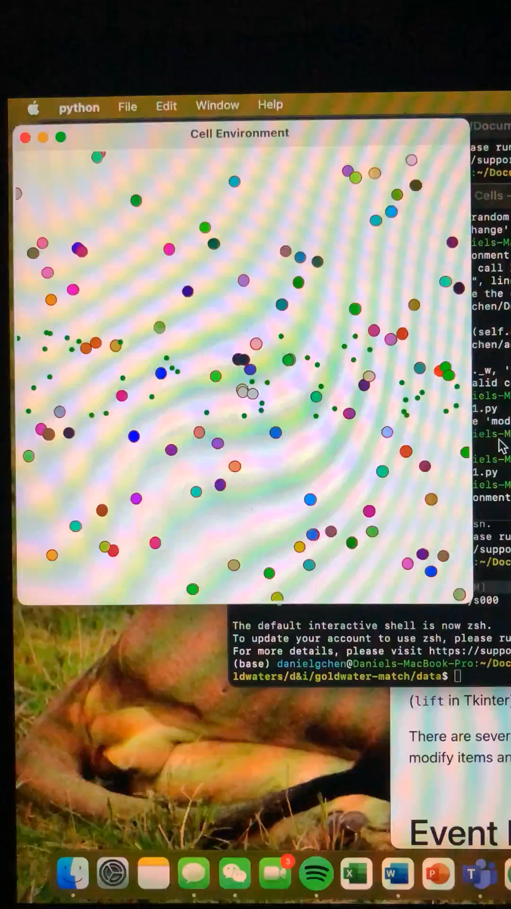
More videos of the same thing

Slide 24
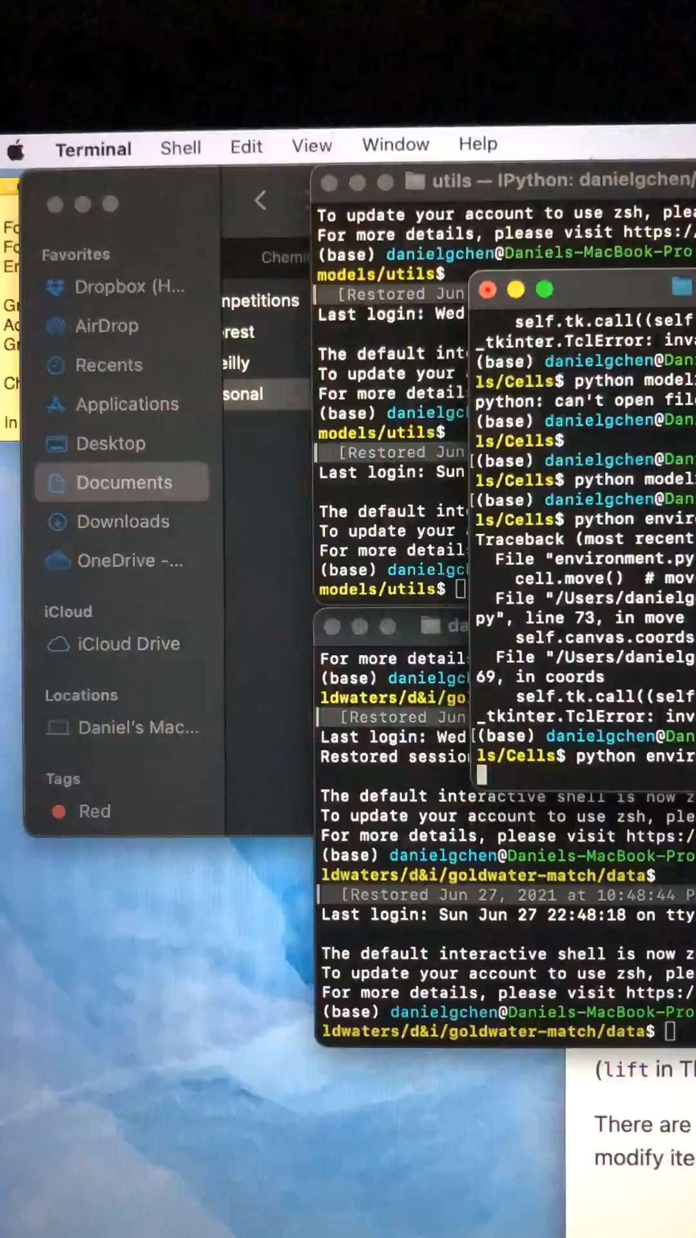
This showed the larger patch of food but the same overall theme is present here

Slide 25
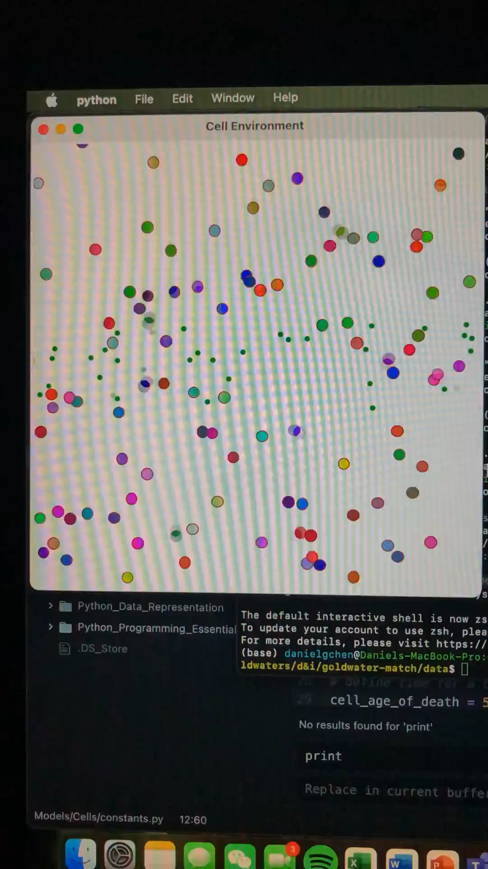
Here’s an example of where mutation allows the cells to move horizontally and you can see wave-like patterns appear this pattern is the few that allows cells not horizontal to start reproducing

